Slide 1


Number Theory and Cryptography
by Dyllan

Slide 2
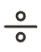

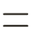
Divisibility and Modular Arithmetic
Divisibility
Division Algorithm
Congruence
For integers a and b with a ≠ 0, we say that a divides b (denoted a | b) if there exists an integer c such that b = ac. When a divides b, a is a factor or divisor of b, and b is a multiple of a.
For an integer a and a positive integer d, there exist unique integers q (quotient) and r (remainder) such that a = dq + r and 0 ≤ r < d. We write q = a div d and r = a mod d.
Two integers a and b are congruent modulo m (denoted a ≡ b (mod m)) if m divides a − b. This is equivalent to saying that a and b have the same remainder when divided by m.

Slide 3
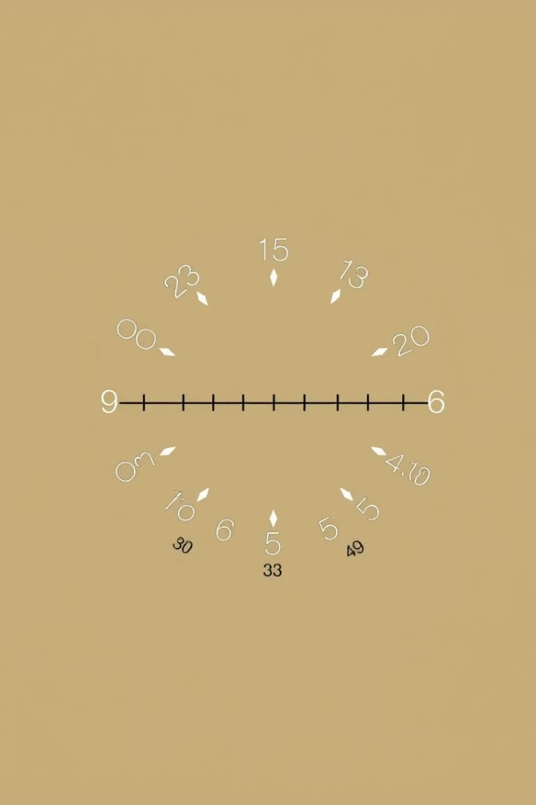
Properties of Modular Arithmetic
Basic Properties of Divisibility
Properties of Congruences
If a | b and a | c, then a | (b + c)
If a ≡ b (mod m) and c ≡ d (mod m), then a + c ≡ b + d (mod m)
If a | b, then a | bc for all integers c
If a | b and b | c, then a | c
If a ≡ b (mod m) and c ≡ d (mod m), then ac ≡ bd (mod m)
Properties of the mod Function
(a + b) mod m = ((a mod m) + (b mod m)) mod m
ab mod m = ((a mod m)(b mod m)) mod m

Slide 4
Integer Representations and Algorithms
Base Representations
Conversion Examples
Any positive integer n can be uniquely expressed in base b (b > 1) as n = akbk + ak−1bk−1 +⋯ + a1b + a0, where 0 ≤ aj < b for all j.
Binary to octal: (11 1110 1011 1100)2 = (37274)8
Octal to binary: (765)8 = (1 1111 0101)2
Hex to binary: (A8D)16 = (1010 1000 1101)2
Common bases include decimal (base 10), binary (base 2), octal (base 8), and hexadecimal (base 16).

Slide 5





Algorithms for Integer Operations
Addition Algorithm
Adds two integers from their binary expansions using carry bits. For n-bit numbers, the complexity is O(n) bit operations.
Multiplication Algorithm
Multiplies integers by computing partial products through shifting and addition. The complexity is O(n²) bit operations for n-bit numbers.
Division Algorithm
Finds quotient and remainder through repeated subtraction. For a > d, the complexity is O(q log a) bit operations.
Fast Modular Exponentiation
Efficiently computes bn mod m using the binary expansion of n and iterative squaring. Crucial for cryptographic applications.

Slide 6





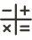


Primes and Greatest Common Divisors
Fundamental Theorem of Arithmetic
Every integer > 1 has a unique prime factorization
Trial Division
Method to determine if a number is prime
Greatest Common Divisor
Largest integer that divides both numbers
Euclidean Algorithm
Efficient method to compute GCD
Prime numbers are integers greater than 1 whose only positive factors are 1 and themselves. The Fundamental Theorem of Arithmetic guarantees that every integer has a unique prime factorization, such as 100 = 2² · 5² or 1024 = 2¹⁰.
The greatest common divisor (GCD) of two integers is the largest integer that divides both. Two integers are relatively prime if their GCD is 1. The Euclidean Algorithm efficiently finds the GCD using successive division steps.

Slide 7
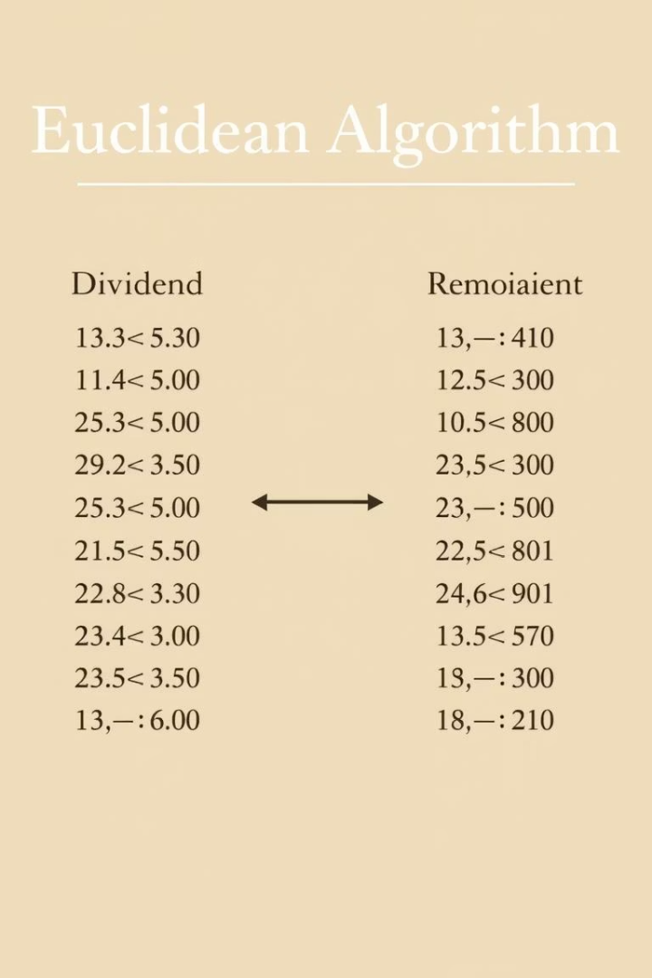
Euclidean Algorithm in Action
Perform Successive Divisions
Divide the larger number by the smaller, then divide the divisor by the remainder, continuing until the remainder is zero. For example, to find gcd(414, 662):
662 = 414 · 1 + 248
414 = 248 · 1 + 166
248 = 166 · 1 + 82
166 = 82 · 2 + 2
82 = 2 · 41 + 0
Identify the Last Non-zero Remainder
The last non-zero remainder is the GCD. In our example, gcd(414, 662) = 2.
Apply Bézout's Identity
For positive integers a and b, there exist integers s and t such that gcd(a, b) = sa + tb. The Extended Euclidean Algorithm finds these coefficients. For example, gcd(252, 198) = 18 = 4 · 252 − 5 · 198.

Slide 8








Solving Linear Congruences
Problem Statement
Find Modular Inverse
Solve a linear congruence of the form ax ≡ b (mod m)
Determine if a⁻¹ exists modulo m (only when gcd(a,m) = 1)
Compute Solution
Apply Extended Euclidean
Multiply both sides by a⁻¹: x ≡ a⁻¹b (mod m)
Use the algorithm to find s where as ≡ 1 (mod m)
A modular inverse of a number a modulo m exists if and only if gcd(a, m) = 1. For example, to find an inverse of 3 modulo 7, we need 3x ≡ 1 (mod 7). Testing values, we find that 3 · 5 = 15 ≡ 1 (mod 7), so 5 is the inverse of 3 modulo 7.

Slide 9



Chinese Remainder Theorem
System of Congruences
Solve systems like x ≡ a₁ (mod m₁), x ≡ a₂ (mod m₂), ..., x ≡ aₙ (mod mₙ)
Verify Conditions
Ensure moduli are pairwise relatively prime: gcd(mᵢ, mⱼ) = 1 for i ≠ j
Compute Solution
Find x ≡ a (mod M) where M = m₁·m₂·...·mₙ using back substitution
The Chinese Remainder Theorem allows us to solve systems of congruences with pairwise relatively prime moduli. For example, to solve x ≡ 1 (mod 5), x ≡ 2 (mod 6), and x ≡ 3 (mod 7), we use back substitution to find x ≡ 206 (mod 210).
This theorem has practical applications in computer arithmetic with large integers, where numbers can be represented by their remainders modulo several primes, allowing for efficient computation.

Slide 10



Applications in Cryptography
Public Key Cryptography
Digital Signatures
Discrete Logarithm Problem
Systems like RSA rely on the computational difficulty of factoring large numbers into their prime components. The security comes from the asymmetry between the ease of multiplying large primes versus the difficulty of factoring their product.
Number theory enables protocols for creating unforgeable digital signatures. These use modular exponentiation and properties of prime numbers to verify the authenticity of messages and the identity of the sender.
Many cryptographic systems rely on the difficulty of finding discrete logarithms. If r is a primitive root modulo p and rᵉ ≡ a (mod p), finding e given r, a, and p is computationally intensive for large primes.

